Slide 1
Develop the Oracle of DSCOVR
By Solar Xplorers :
Manar El Bagoury
Nour Kamaly

Slide 2
What is a geomagnetic storm ?

Slide 3
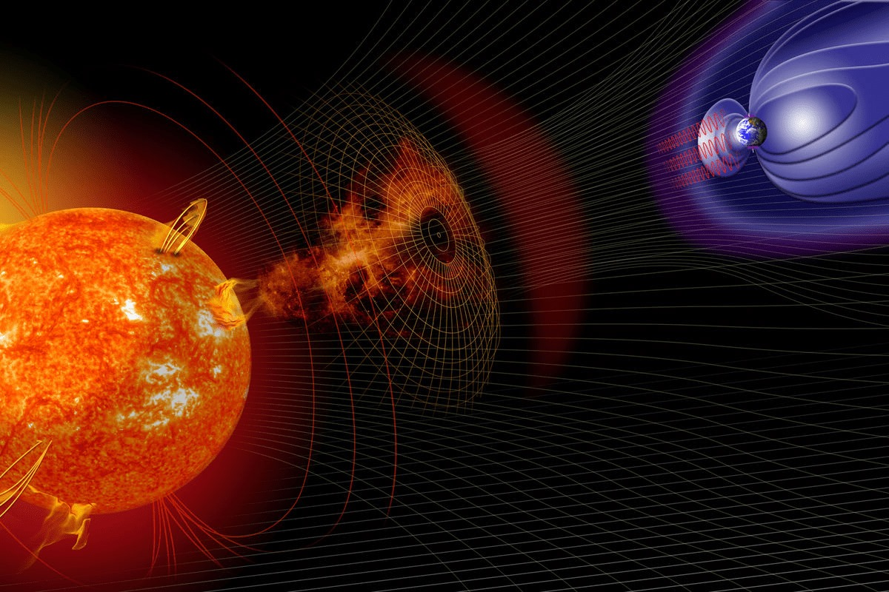
Geomagnetic storms are disturbances that occur in the Earth's magnetic field. The Earth has a magnetic field that extends from its core out into space, and it plays a vital role in protecting our planet from the harmful effects of the solar wind, which is a stream of charged particles emitted by the Sun.

Slide 4
Effects of Geomagnetic Storms
Can cause power outage, interrupt radio communications
Alteration in blood pressure, adrenaline, blood flow
Disruption of technological systems
Irritation of melatonin balance
Exposure to elevated levels of radiation

Slide 5
Proposed Kp Index Prediction Solution Pipeline

Slide 6
Proposed Solution Pipeline
01
02
03
04
Data Integration
Data Analysis
Preprocessing
Modeling

Slide 7

1. NASA NOAA Real-Time Solar Wind Dataset
10 different time series version
2 Hours @1 sec
6 Hours @1 min
1 day @1 min
.
.
5 years @ 1 day
26 years @ 5 days
1 central data repository that has data from 1998 till
3/10/2023

Slide 8

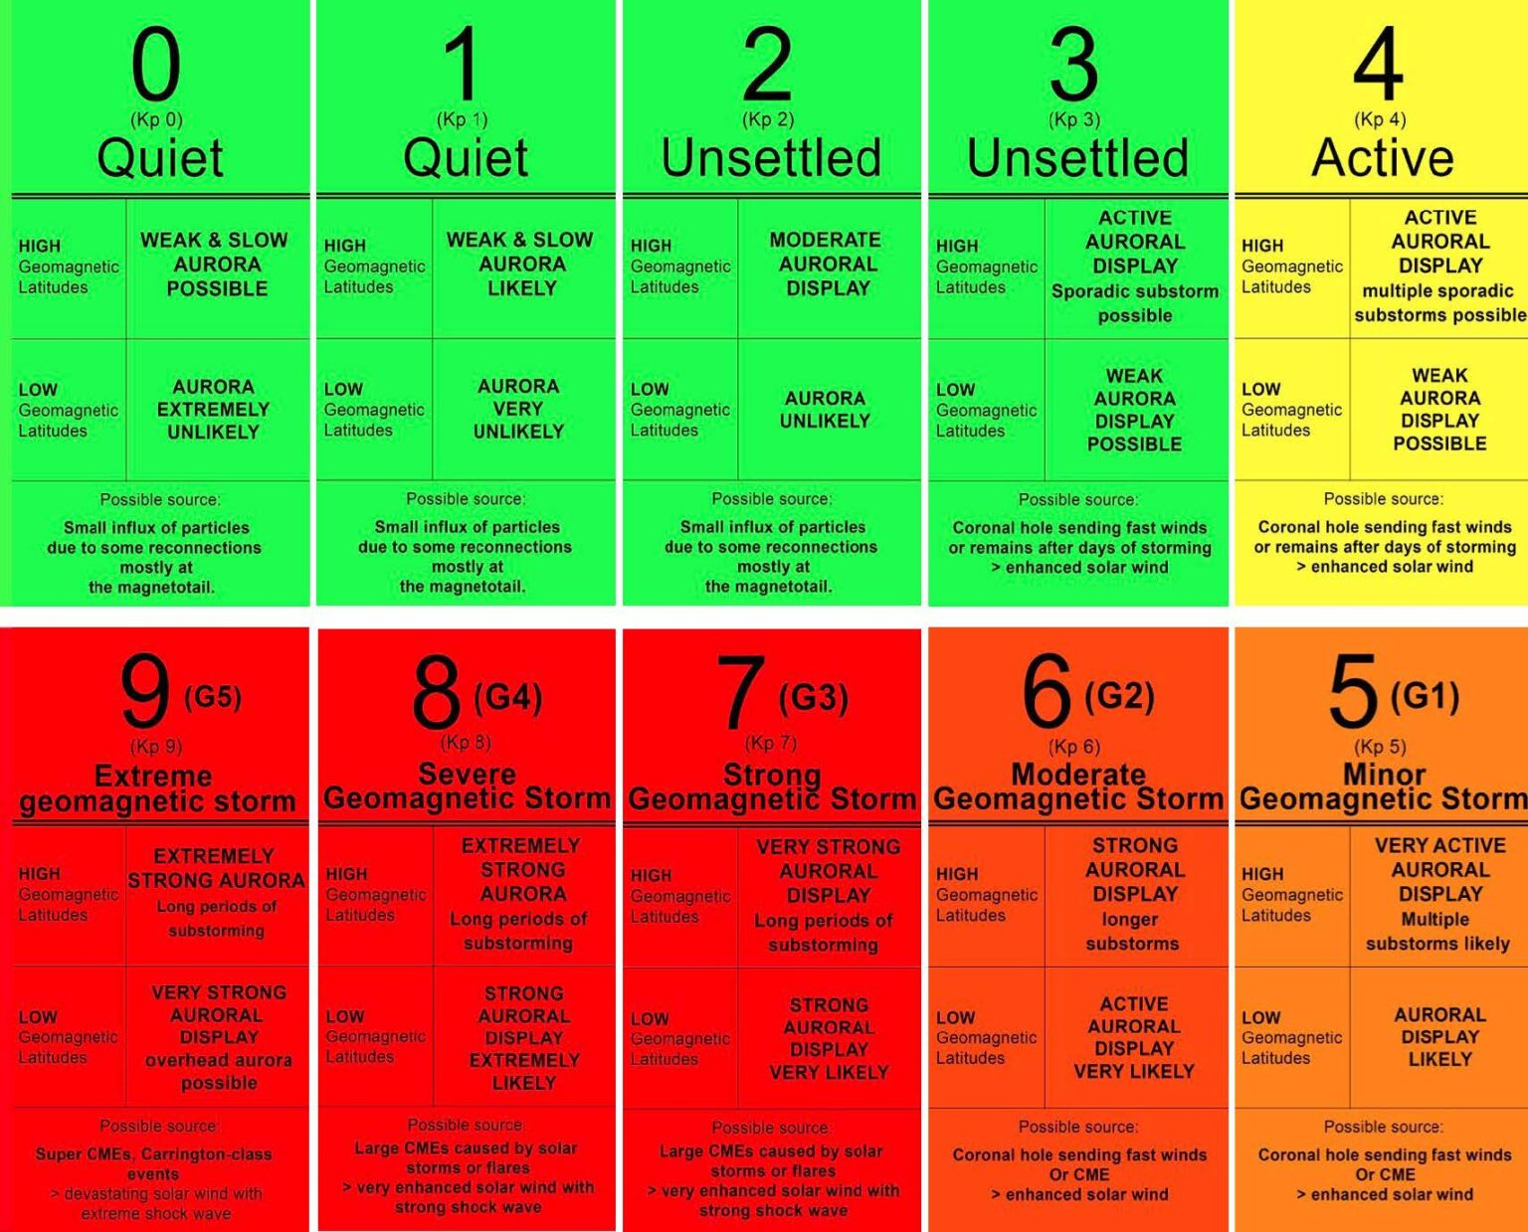
2. International Association of Geomagnetism and Aeronomy

Slide 9
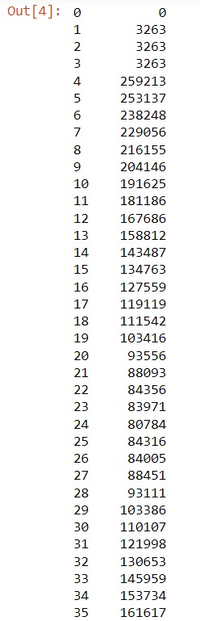
3. Experimental Data Repository
- The data files in this repository contain measurements from the DSCOVR PlasMAG instrument suite, recorded in the solar wind near the Earth-Sun L1 Lagrange Point between 2016 and present day.
- Represents a "raw" measurement spectrum from the Faraday cup plasma detector. Each value corresponds to the flux, or flow strength, of the solar wind in a particular range of energies (or flow speeds). These numbers are not calibrated or converted-- they are dimensionless numbers as encoded in the instrument computer.
- After some exploratory data analysis, the data was full of null values, so we decided not to proceed forward with this dataset

Slide 10
03
Preprocessing

Slide 11
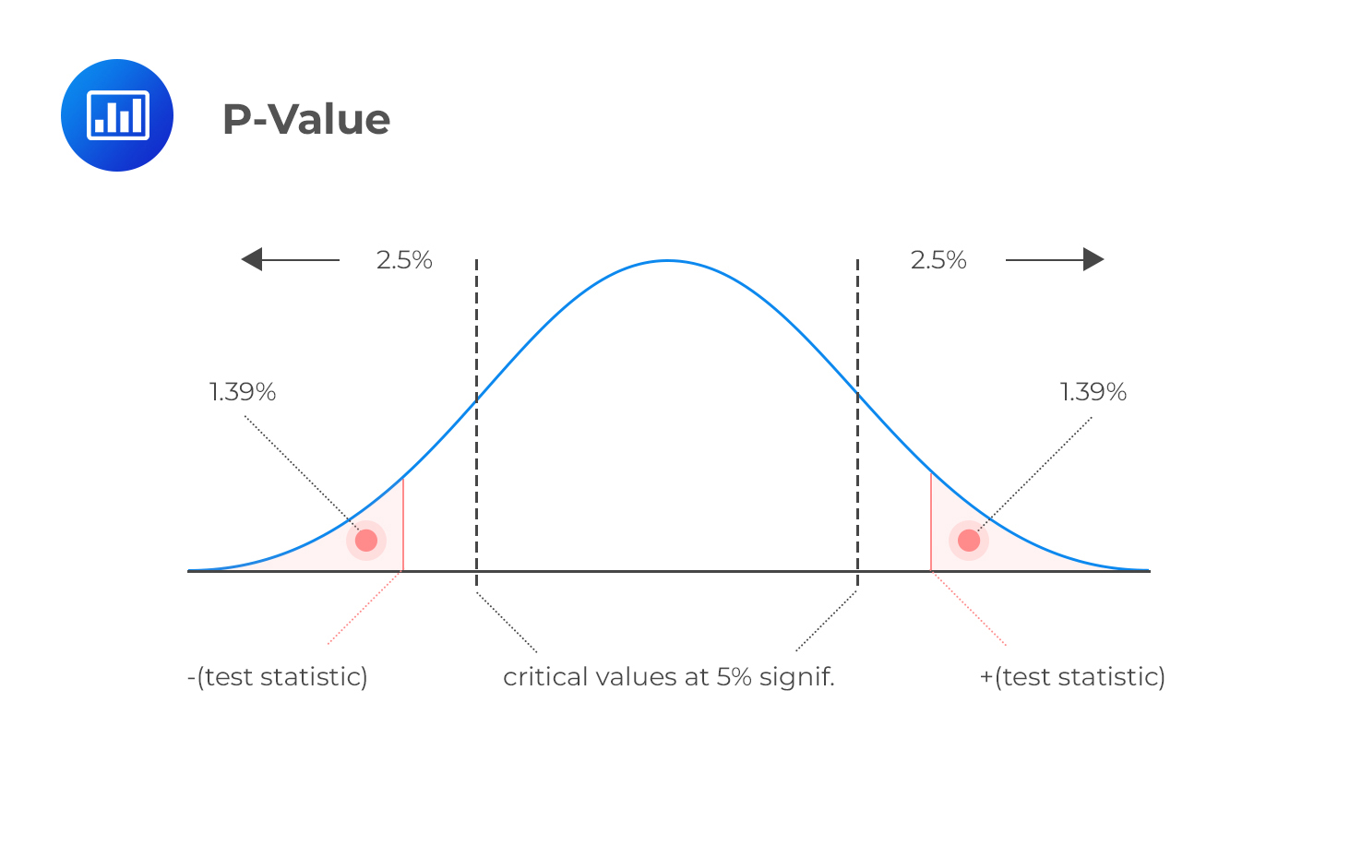
Significance Testing
Significance testing is used to determine which features we should use based a hypothesis, if the confidence of the hypothesis is less than a specified value, then we reject the null hypothesis and drop the feature

Slide 12
04
Modeling

Slide 13
Machine Learning Approach
Boosting Ensemble Learning: Random Forest, Gradient Boosting Tree
Bagging Ensemble Learning: Bagging Regressor
Statistical Methods: Poison regressor
Traditional Machine Learning: Decision Trees, Linear Regression

Slide 14

Kp Index Results
GBR – MAE: 0.77
RF – MAE: 0.8
ETR – MAE: 0.82
BG – MAE: 0.84
BG
ETR
RF
GBR

Slide 15
Solution 2 Pipeline
01
02
03
04
Data Integration
Data Analysis
Preprocessing
Modeling

Slide 16
Proposed DST Prediction Solution Pipeline

Slide 17
4. NASA SPDF OMNI Hourly Data Set
Contains the hourly mean values of the interplanetary magnetic field (IMF) and solar wind plasma parameters measured by various spacecraft near the Earth's orbit, as well as geomagnetic and solar activity indices, and energetic proton fluxes known as OMNI2 data.
Dated from 1963 to 2023

Slide 18
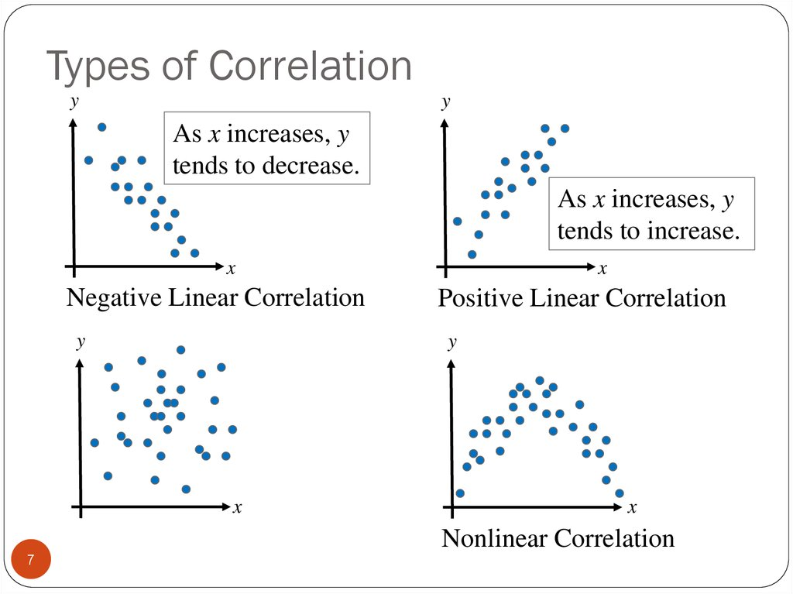
Data Analysis and Significance Testing
P-Value
Correlation Coefficient

Slide 19
Machine Learning Approach
Extra Tree Regressor
Gradient Boosting Regressor
Hist Gradient Boosting Regressor
Linear SVR

Slide 20
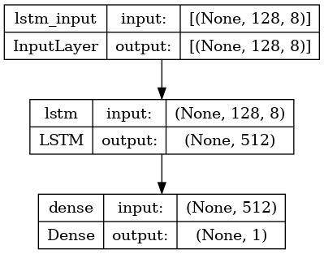
Deep Learning Approach

Slide 21
Dst Index Results
SVR – R^2: 0.32
ETR – R^2: 0.38
GBR – R^2: 0.42
HGBR – R^2: 0.43
SVR
ETR
HGBR
GBR
LSTM – RSME: 18.1

Slide 22
Thank you for listening
Solar Xplorars Team

